Slide 1
Adaptive Random Forest with Resampling for Imbalanced data Streams Data Mining Lab SS2020 (Presentation I)
Kush Varma (kush.varma@stud.uni-hannover.de)

Slide 2
Outline
Introduction
Problem Statement
Class Imbalance
Solution: Adaptive Random Forest with Resampling
Moa & scikit-multiflow
ARF_RE in Python
Pseudo Code
Dataset
Performance Metrics
Current Status
Next Steps

Slide 3
Introduction
Large volume of continuous Real time Streams
Traditional ML algorithm works in batch with fixed data set
Traditional algorithm can not be applied for streams
Algorithms which solves these issue
Online Bagging
Adaptive Random Forest
Imbalance datasets
Imbalance datasets in streams
ARF with Resampling

Slide 4
Problem Statement
Classification problem involving imbalanced data, in context to data streams
Traditional classification algorithms focus on Representative instances, hence neglecting minority instances
In streams, problem become more evident, reducing observation of minority instances.
Delay in discovery of existing patterns
Also faces concept drifts

Slide 5
Class Imbalance
Imbalanced data is characterized by having more instances belonging to one class than others.
Minority class instances rarely occurs.
Rare, undiscovered or ignored classification.
How to deal with class imbalance?
Traditionally it can be solved using:
Sampling
Ensembles
Cost-sensitive methods
For streaming: Hybrid solution: ARF with Resampling: ARF_{RE}

Slide 6
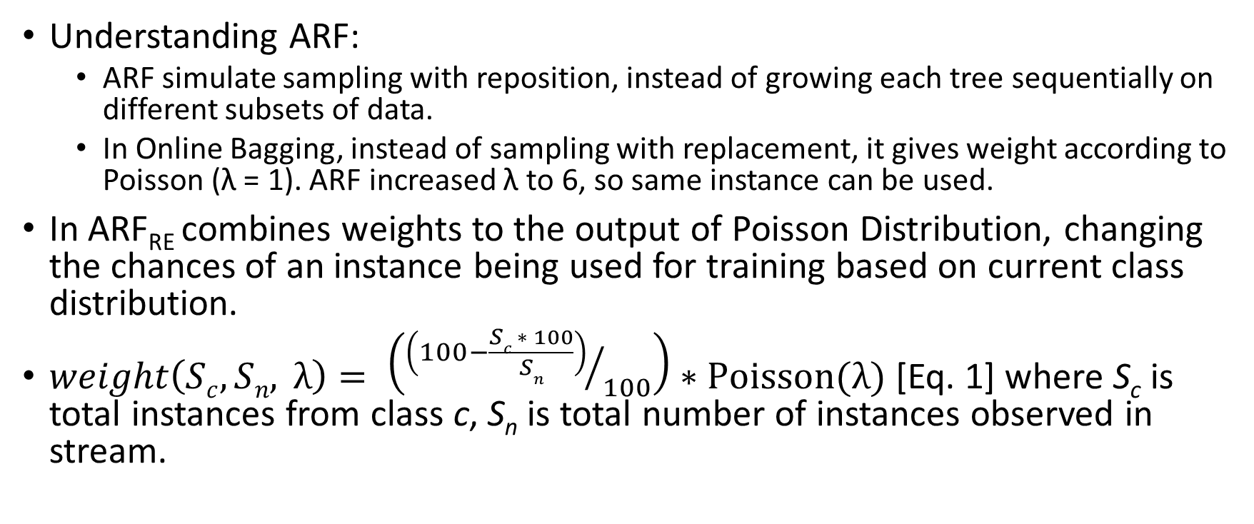
Solution: Adaptive Random Forest with Resampling (ARF_{RE})
Understanding ARF:
ARF simulate sampling with reposition, instead of growing each tree sequentially on different subsets of data.
In Online Bagging, instead of sampling with replacement, it gives weight according to Poisson (λ = 1). ARF increased λ to 6, so same instance can be used.
In ARF_{RE} combines weights to the output of Poisson Distribution, changing the chances of an instance being used for training based on current class distribution.
$weight\left(Sc, Sn, λ\right)= \left({\left(100−\frac{Sc ∗ 100}{Sn}\right)}/{100}\right)∗Poisson(λ)$ [Eq. 1] where S_{c} is total instances from class c, S_{n} is total number of instances observed in stream.

Slide 7
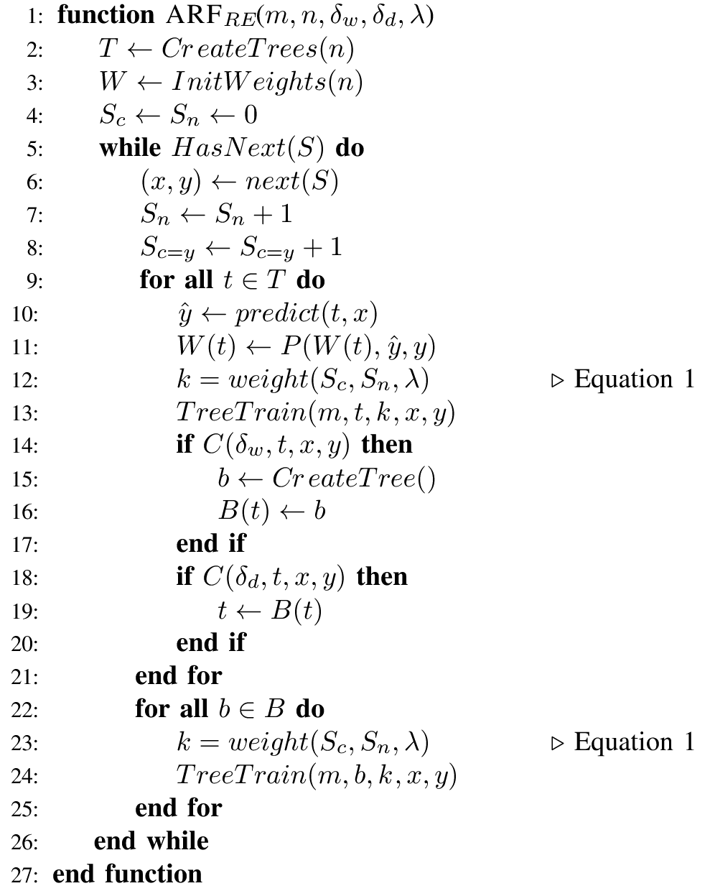
ARF_{RE} Algorithm
ARF with resampling.
Symbols: m: maximum features evaluated per split
n: total number of trees
δ_{w}: warning threshold
δ_{d}: drift threshold
c(·): change detection method
S: Data stream
B: Set of background trees
W(t): Tree t weight
P(·): Learning performance estimation function
S_{n}: Current instance counter
S_{c}: Number of occurrences of class label c
λ: Expected value and variation of a Poisson distribution

Slide 8
MOA & scikit-multiflow
Moa: Massive Online Analysis
Java based ML tool for stream
ML Algo: classification, regression, clustering, outlier detection, concept drift detection and recommender systems and tools for evaluation.
Experiments in the paper were performed on MOA with ARF_{RE} extension.
Scikit-multiflow
Inspired by MOA
Inspired on scikit-learn
multi-output/multi-label and stream data.
We are adding ARF_{RE} in scikit-multiflow.

Slide 9
Datasets
Currently we are considering 5 data sets, 4 real and 1 synthetic.
AIR: Airline dataset, task is to predict which flights are going to be delayed based on information on the scheduled departure.
ELEC: Electricity dataset, task is to predict whether the electricity prices are going up or down relative to moving avg of last 24h.
GMSC: Goal is to predict whether a loan should be allowed.
COVTYPE: A forest cover type for 30X30 m cell, where each cover types represented by one of the seven classes
SEA Generator: Produces data streams with three continuous features.

Slide 10
Performance Metrics
Prequential evaluation(PE) with the recall
test-then-train approach.
best for estimating error on data streams.
Faster response for detecting drifts
Recall is best metric to access performance when dealing with imbalanced dataset.
Macro Avg of Recall, CPU time to train and update the model.
Testing ARF_{RE} with ARF also with state-of-the-art ensembles classifier like: Leveraging bagging, online bagging learnNSE and Online accuracy update ensemble.

Slide 11
Current Status
Performed evaluate prequential of ARF_{RE}, ARF, LB, OZA, L. NSE & OAUE using MOA with following data set:
AIR
GMSC
ELEC
COVTYPE
SEA
Started porting the code from Java to python. More here: (https://github.com/kushvarma/dm_arf & https://github.com/kushvarma/scikit-multiflow )

Slide 12
Next Steps
Porting the code of ARF_{RE} from MOA (Java) to scikit-multiflow(Python)
Performing Prequential evaluation using scikit-multiflow.
Comparing with state-of-the-art ensembles.
Perform experiment with more datasets in both MOA and scikit-multiflow.

Slide 13
Thank You

Slide 14
Adaptive Random Forest with Resampling for Imbalanced data Streams Data Mining Lab SS2020 (Presentation II)
Kush Varma (kush.varma@stud.uni-hannover.de)

Slide 15
Outline
Result for PIMA and WEATHER dataset
Overall results
MOA to scikit-multiflow porting status

Slide 16
Result for PIMA and WEATHER dataset
My findings
Paper findings
PIMA | Recal [0] | Recall[1] | CPU seconds |  | Recal [0] | Recall[1] | CPU seconds
ARF_RE | 79.6 | 61.94 | 0.078 |  | 81 | 66.04 | 0.34
ARF | 87.2 | 49.25 | 1.09 |  | 87.6 | 54.48 | 1.18
L NSE | 87 | 36.56 | 0 |  | 87 | 36.57 | 0.08
LB | 83.6 | 53.73 | 0.03 |  | 83.6 | 53.73 | 0.2
OZA | 78.2 | 59.32 | 0.015 |  | 78.2 | 59.33 | 0.14
OAUE | 94.8 | 19.4 | 0 |  | 94.8 | 19.4 | 0.05
WEATHER | Recal [0] | Recall[1] | CPU seconds |  | Recal [0] | Recall[1] | CPU seconds
ARF_RE | 56.46 | 85.46 | 1.65
ARF | 81.54 | 8.3 | 39.98
L NSE | 65.93 | 68.57 | 0.5
LB | 73.34 | 72.95 | 1.29
OZA | 70.5 | 65.84 | 0.37
OAUE | 74.13 | 71.584 | 0.718

Slide 17
Precision, Accuracy, Kappa, F1 and recall for WEATHER dataset
Accuracy | 67
Precision | 86.97
Precision(class 0) | 86.89
Precision(class 1) | 53.06
Recall | 70.85
Recall (class 0) | 56.46
Recall (class 1) | 85.46

Slide 18
Overall Result
My findings
Paper findings
My findings
Paper findings
COVTYPE | Recal [2] | Recall[5] | CPU seconds |  | Recal [2] | Recall[4] | CPU seconds
ARF_RE | 99.65 | 93.93 | 176 |  | 95.44 | 82.58 | 289.22
ARF | 99.3 | 93.18 | 1894 |  | 96.72 | 78.12 | 448.18
L NSE | 65.32 | 96.96 | 2281 |  | 71.18 | 30.73 | 4000.93
LB | 98.38 | 94.69 | 111 |  | 94.17 | 75.94 | 197.19
OZA | 94.81 | 82.57 | 42.5 |  | 90.87 | 42.59 | 79.86
OAUE | 96.88 | 93.939 | 102 |  | 92.46 | 76.52 | 163.56
SEA | Recal [0] | Recall[1] | CPU seconds |  | Recal [0] | Recall[1] | CPU seconds
ARF_RE | 78.9 | 94.8 | 108.23 |  | 80.68 | 94.34 | 173.55
ARF | OOM | OOM |  |  | 80.28 | 94.63 | 246.47
L NSE | 71.38 | 93.27 | 588 |  | 72.91 | 93.22 | 1260.47
LB | 80.34 | 95.56 | 39.41 |  | 80.61 | 94.93 | 74.84
OZA | 80.63 | 95.56 | 13.25 |  | 80.36 | 94.8 | 21.8
OAUE | 80.05 | 95.25 | 26.7 |  | 80.57 | 94.85 | 46.65
PIMA | Recal [0] | Recall[1] | CPU seconds |  | Recal [0] | Recall[1] | CPU seconds
ARF_RE | 79.6 | 61.94 | 0.078 |  | 81 | 66.04 | 0.34
ARF | 87.2 | 49.25 | 1.09 |  | 87.6 | 54.48 | 1.18
L NSE | 87 | 36.56 | 0 |  | 87 | 36.57 | 0.08
LB | 83.6 | 53.73 | 0.03 |  | 83.6 | 53.73 | 0.2
OZA | 78.2 | 59.32 | 0.015 |  | 78.2 | 59.33 | 0.14
OAUE | 94.8 | 19.4 | 0 |  | 94.8 | 19.4 | 0.05
WEATHER | Recal [0] | Recall[1] | CPU seconds |  | Recal [0] | Recall[1] | CPU seconds
ARF_RE | 56.46 | 85.46 | 1.65
ARF | 81.54 | 8.3 | 39.98
L NSE | 65.93 | 68.57 | 0.5
LB | 73.34 | 72.95 | 1.29
OZA | 70.5 | 65.84 | 0.37
OAUE | 74.13 | 71.584 | 0.718
GMSC | Recal [0] | Recall[1] | CPU seconds |  | Recal [0] | Recall[1] | CPU seconds
ARF_RE | 89.13 | 65 | 8.43 |  | 90.05 | 56.37 | 14.51
ARF | 99.13 | 18.75 | 178 |  | 99.27 | 12.66 | 49
L NSE | 77.92 | 53.731 | 23.05 |  | 76.57 | 51.83 | 70.04
LB | 99.23 | 18.75 | 8.61 |  | 99.47 | 10.38 | 16.86
OZA | 99.67 | 6.25 | 2.77 |  | 99.66 | 7.58 | 5.59
OAUE | 99.02 | 12.5 | 6.19 |  | 99.64 | 7.5 | 11.76
ELEC | Recal [0] | Recall[1] | CPU seconds |  | Recal [0] | Recall[1] | CPU seconds
ARF_RE | 94.86 | 89.86 | 4.55 |  | 86.81 | 91.44 | 9.54
ARF | 95.93 | 90.43 | 64.12 |  | 85.41 | 92.13 | 11.08
L NSE | 68.09 | 74.48 | 2.17 |  | 70.15 | 71.74 | 6.37
LB | 93.36 | 90.99 | 3.22 |  | 85.67 | 92.74 | 7.08
OZA | 87.36 | 88.74 | 0.92 |  | 76.7 | 86.64 | 1.91
OAUE | 93.14 | 90.24 | 1.89 |  | 83.91 | 90.56 | 3.72
AIR | Recal [0] | Recall[1] | CPU seconds |  | Recal [0] | Recall[1] | CPU seconds
ARF_RE | 55.28 | 65.48 | 271 |  | 67.93 | 56.05 | 396.76
ARF | 65.33 | 61.93 | 2495 |  | 71.34 | 51.88 | 544.46
L NSE | 56.49 | 59.1 | 746 |  | 67.94 | 55.4 | 985.42
LB | 59.44 | 58.39 | 311 |  | 74.73 | 48.72 | 502.04
OZA | 74 | 48.69 | 47.19 |  | 84.09 | 41.07 | 67.95
OAUE | 67.41 | 62.17 | 192.3 |  | 81.37 | 50.27 | 295.78

Slide 19
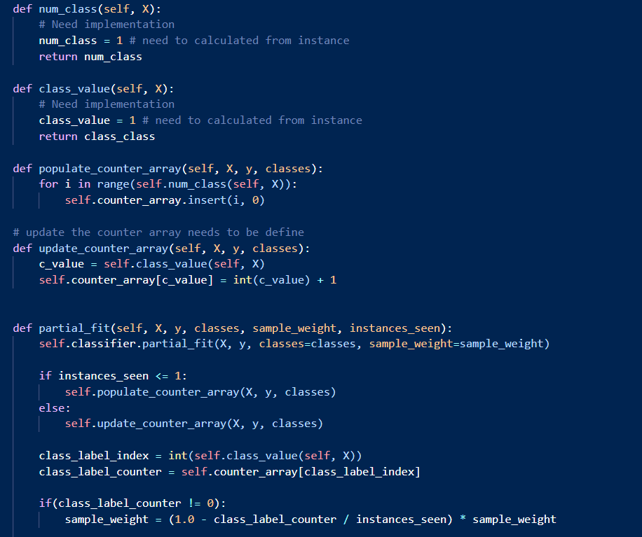
MOA to scikit-multiflow porting status
class_label_index = int(self.class_value(self, X))
class_label_counter = self.counter_array[class_label_index]
if(class_label_counter != 0):
sample_weight = (1.0 - class_label_counter / instances_seen) * sample_weight
Branch name: dm_arf
Code: https://github.com/kushvarma/scikit-multiflow.git
File: src/skmultiflow/meta/adaptive_randon_forest_re.py
Need implementation for num_class and class_value.

Slide 20
Thank You

